Slide 1


Project - HealthMon
Priti Rahalkar

Slide 2

HealthMon
Business Need & Intervention
Health Information Flow
Stake Holders
ASHA
Console
Dashboard
List of Reports
AWW
Console
Dashboard
List of Reports
ANM
Console
Dashboard
List of Reports
MO/Consultant
Console
Dashboard
List of Reports
Patient
Console
Dashboard
List of Reports
Health Officer
Console
Dashboard
List of Reports
Admin
Console
List of Reports
Proposed Devices
Use Cases
Sample Mockups

Slide 3
The Business Problem & Intervention spectrum
TAB/Mobile-based interventions with POC device integration & Interactive tools with text , voice, pictures in English as well as local language can be used to strengthen Anemia, Malnutrition Prevention, treatment and management for Adolescents , Pregnant Women & Children
Population
Prevention
Treatment
Awareness
Enforcement
Cessation and Surveillance

Slide 4
Health Information Flow Structure
DHO
Specialist, District Health Officer
Civil/District Hospital
> 1,00,000 population
Health Officer Block level
Rural Hospital
1,00,000 population
MO/ANM, ASHA,AWW,MPW
1 PHC : 1 ANM/MO
PHC
PHC : 20,000 - 30,000 (population)
ASHA,AWW
1 HW : 1,000 population
Sub Center- 5,000 (population)
SC
SC
SC
SC
SC

Slide 5
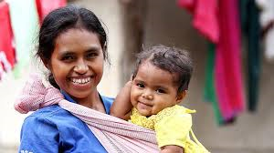
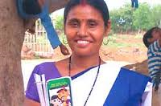
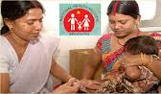

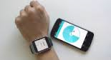

Care Team & Stake Holders
ASHA/AWW
ANM
Patient
Mother & Child
MO/Specialist Console
Health Officer
Admin Console

Slide 6

ASHA – Accredited Social Health Activist

Slide 7
ASHA(Accredited Social Health Activist)- Tasks
Population Survey by Home visits
Eligible couple , Adolescent & Health Survey
Conducts Patient Assessment
Educating /Counselling Patient :counsel women and families on birth preparedness, importance of safe delivery, breastfeeding and complementary feeding, immunization, contraception , STD& RTI
Records Demographics, Family history of Patient
Captures Vital , anthropometric data
Holding meetings for village health – Promoting construction of household toilets under total Sanitation Campaign.
Managing Kit Inventory
Providing Medications to Patients as per Care Plan
Provide primary medical care to minor ailment like fever, diarrhea(ORS), fever, first aid for minor injury
Providing folic acid, calcium, iron ,oral pills, condoms etc..
Attending meetings with ANM & AWW
Attending Health Training defined by government
Maintaining records :Population coverage, households allocated, training inputs received, and performance, data on drop-outs, Family planning register, birth & death register, new appointments etc..

Slide 8
ASHA Console
ASHA Console
ASHA records, views the activities related to Prenatal, Intranasal, Postnatal care of beneficiary
ASHA Apps/Modules :
Patient Survey (Identification)
Health Assessment
Patient Education/Counselling
Data Recording (Demographics, Vital, Vitamin supply , Inventory , Medication Refill ,Education needs..)
Registration
Health Status Tracking
Collaboration(Phone , SMS, Chat, Video Conferencing)
Patient Satisfaction Survey
Self Training
Survey
Health Assessment
Registration
Capture Vitals/ Investigations
Appointment Scheduling/ Referral
Educate/Counsel
Feedback
SMS/Chats/Emails
Dashboard
Notes:
RCH – Reproductive and Child Health Care Program
ICDS – Integrated Child Development Scheme

Slide 9
ASHA Dashboard
ASHA Console
Details of Beneficiaries
Log of Health Survey
Women Health Record
Log of Vitals, health data captured and treatment given
Immunization details
Details of Health Check up Camps conducted
Inventory record – Medications, instruments, disposables
Log of training needs & training provided to beneficiaries
Log of trainings attended
Log of referral
Eligible couple register
ANC register
Infection (RTI/STI ) Register
High risk pregnancy register
Janani Suraksha Expenditure Register
Behavior Change communication Register (BCC)
Sterilization Register
ASHA maintains and views Reports/Registers

Slide 10
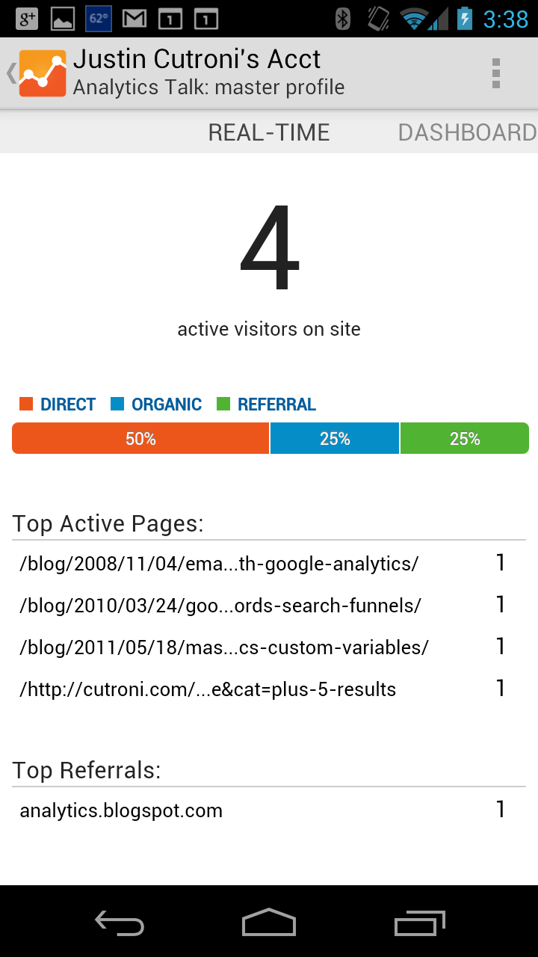
ASHA Dashboard
ASHA Console
ASHA views Reports/Registers
ASHA Dashboard
Patient Survey (Identification)
Health Assessment
Patient Education/Counselling
Data Recording (Demographics, Vital, Vitamin supply , Inventory , Medication Refill ,Education needs..)
Registration
Health Status Tracking
Collaboration(Phone , SMS, Chat, Video Conferencing)
Patient Satisfaction Survey
Self Training

Slide 11
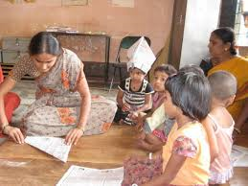
AWW – AnganWadi Worker

Slide 12
AWW (Anganwadi Worker) - Tasks
Arranging & Providing Supplementary Nutrition to children from 0-6 yrs.
Supplementary feeding, Vitamin A ,Vitamin D,
Provides Immediate services for diarrhea, cholera, fever
Conducting Home visits & providing cooked food, food grains
Providing Non formal preschool education
Patient / Child Registration
Records data for Child demographics, vitals, symptoms, growth (height ,weight),temperature
Immunization - tetanus, tuberculosis, measles etc.
Organizing Health Check-up camp with PCH
Referring malnourished child to the PHC
Providing Nutrition & Health education - Personal hygiene..
Attending monthly meetings held ASHA & ANM
Maintaining Child record Card and tracking growth
Maintaining records of Infections or diseases ,Birth & death Register ,Immunization, malnourished child Dropout or left out beneficiaries

Slide 13
AWW Console
AWW Console
AWW records, views the activities related to 0 to 6yrs Children
AWW App/Modules :
Health Assessment App
Registration
Patient education/Counselling
Data Recording (Vitals, Immunization, Diet, Supplementary Nutrition, Weight..)
Health Status Tracking
Collaboration(Phone , SMS, Chat, Video Conferencing)
Self Training
Conduct Survey
Health Assessment
Registration
Capture Vitals/ Anthropometric data
Educate/Counsel
SMS/Chats/Emails
Dashboard
Feedback
Notes:
AWW -Angan Wadi Worker

Slide 14
AWW Dashboard
AWW Console
Details of Beneficiaries
Log of Health Survey
Child Growth Record
Log of Vitals, health data captured and treatment given
Immunization details
Details of Health Check up Camps conducted
Inventory record – Medications, instruments, disposables
Log of training needs & training provided to beneficiaries
Log of trainings attended
Log of referral
Birth register
Child death register
T.B Register
Children diseases register
Expenditure Register
Vitamin A,D .. register
AWW maintains and views Reports/Registers
Notes:
AWW -Angan Wadi Worker

Slide 15
AWW Console
AWW Console
AWW Console
AWW views Reports
Health Assessment App
Registration
Patient Education/Counselling
Data Recording (Vitals, Immunization, Diet, Supplementary Nutrition, Weight..)
Health Status Tracking
Collaboration(Phone , SMS, Chat, Video Conferencing)
Self Training
Notes:
AWW -Angan Wadi Worker

Slide 16
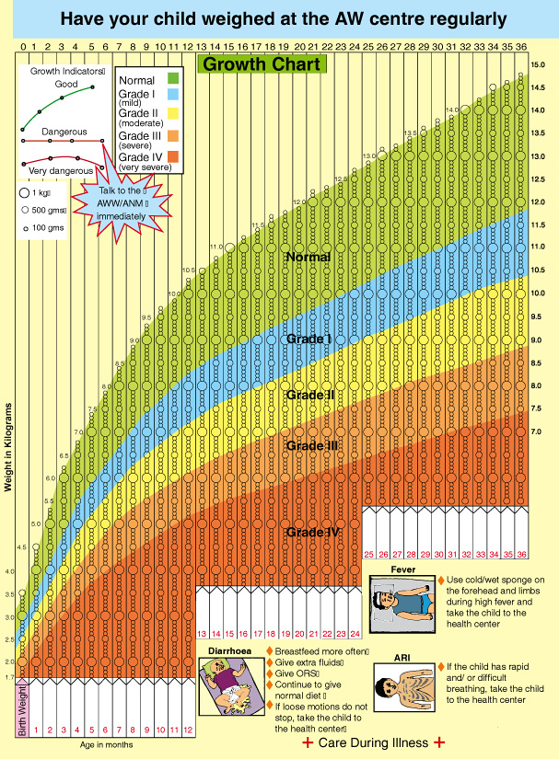
AWW Dashboard - Child Growth Chart
AWW Console
AWW views Dashboard

Slide 17
ANM – Auxiliary Nurse Midwifery

Slide 18
ANM (Auxiliary Nurse Midwifery) - Tasks
Patient Registration
Patient Education on Care Plan
Patient Screening
Data Recording / Maintenance (Demographics, Vitals, Immunization..)
Organizing Immunization camps. Providing immunization - TT, Tuberculosis, poliomyelitis, diphtheria etc..
Tracking Patient Health Status
Patient Referral
Organizing meetings with Care team
Organizing Nutrition day, Heath check up camps
Conducting trainings for ASHA, AWW workers and supporting them for availing services needed
Maintaining Patient Health Records and Reports
Maintaining Records of High Risk Pregnancy, Dropout/left out beneficiaries , Immunization, Health Check ups, Anemia trends

Slide 19
ANM Console
ANM Console
ANM records, views the activities of Patient
ANM Modues/Apps :
Health Assessment
Registration
Data Recording (Vitals, Symptoms, Immunization..)
Investigations – Use of Medical devices integrated with App
Care Plan Creation
Referral
Health Status Tracking
Collaboration(Phone , SMS, Chat, Video Conferencing)
Health Assessment
Registration
Investigations/Immunizations /Vitals
Educate/Counsel
Referrals
SMS/Chats/Emails
Dashboard
Feedback
Notes:
AWW -Angan Wadi Worker

Slide 20
ANM Dashboard
ANM Console
Details of Beneficiaries
Immunization details
Health Checkup registers
Birth /Death Registers
Trainings to AWW, ASHA
Team Huddle
Medication ,Vitamins , instruments inventory Management
AWW maintains and views Reports/Registers
Notes:
AWW -Angan Wadi Worker

Slide 21
Medical Officer/Consultant/Specialist

Slide 22
Consultant / MO (Medical Officer) - Tasks
OP/IP Visit Management
Diagnosis
Treatment
Health Status Monitoring
Care Plan Creation/Approval
Referral Management
Visits, Health Checkups Management
Education & Counselling
Clinical Assessment

Slide 23
MO/Consultant Console
MO/Consultant Console
MO/Consultant records, views the diagnosis , treatment and trends of beneficiaries
My Patients
Care Plan Management
Health Status Tracking
Treatment
SMS/Chats/Emails
My Calendar
Dashboard
Referrals

Slide 24
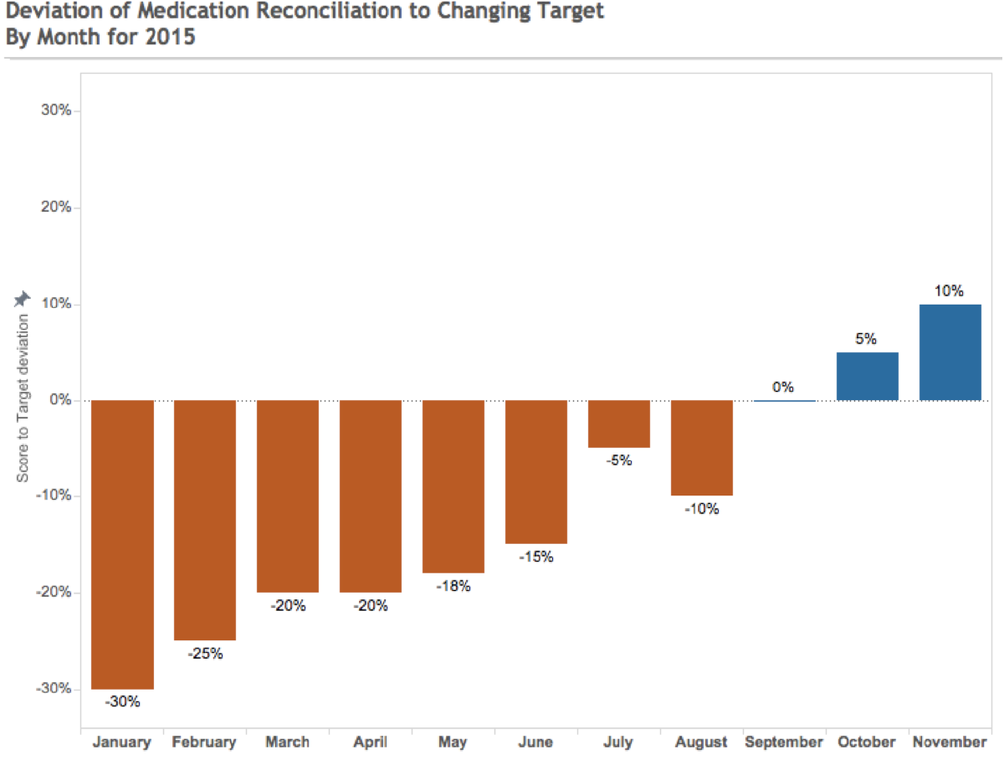
Medication Reconciliation of My Patients
MO/Consultant Console
Consultant/MO views all the information which includes Demographics, Conditions, Current Medications, assessments completed, etc.
She can also view the ‘Care Plan Goals’ and ‘Appointments’ created for her

Slide 25
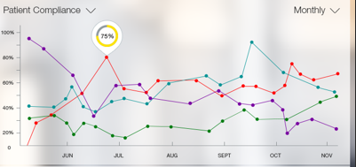
Compliances
MO/Consultant Console
Consultant/MO views all the Program level, Patient level compliances

Slide 26
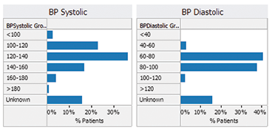
BP Trends Monitoring of Patients
MO/Consultant Console
Consultant/MO views all the information which includes Demographics, Conditions, Current Medications, BP, Hb, Glucose level monitoring, BMI, HbA1C etc..

Slide 27
MO/Consultant Dashboard
MO/Consultant Console
% of Enrolled Beneficiaries – Age wise, diagnosis wise
List of Patients crossing normal ranges
% drop outs
Performance/ Health Status of Beneficiaries
Missed records- Immunization, Medications, Check ups
MTP trends
High risk patients
Referral cases
Birth Records
Death Records
Delivery Records
MO/Consultant views Dashboard
MO/Consultant Apps/Modules :
OP/IP Patient Management
Referral Management
Collaboration with team
Reports/Analytics
Care Plan view/ Creation/Approval
Clinical Assessment & Management

Slide 28
Patient – Pregnant Women & Child

Slide 29
Patient Console
Patient Console
Patient Logs into HealthMon App
My Tasks/Calendar
My Care Plan
Education Links Audio, Video
Alerts/SMS
My Health Reports
Feedback
Help

Slide 30
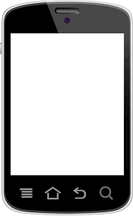
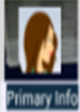

Patient View – Tasks (Kick Count of Baby)
Patient Console
Patient records, views her own Tasks
Views Documents, Videos
Views/Receives Alerts , Text & voice Messages
Patient Moduels/Apps:
Self Management
Health Status Monitoring
Education/Counselling sessions
Feedback
Collaboration
Laxmi Shejul
Start Kick Count
Alerts/Reminders
My Care Plan
Trends
Help

Slide 31
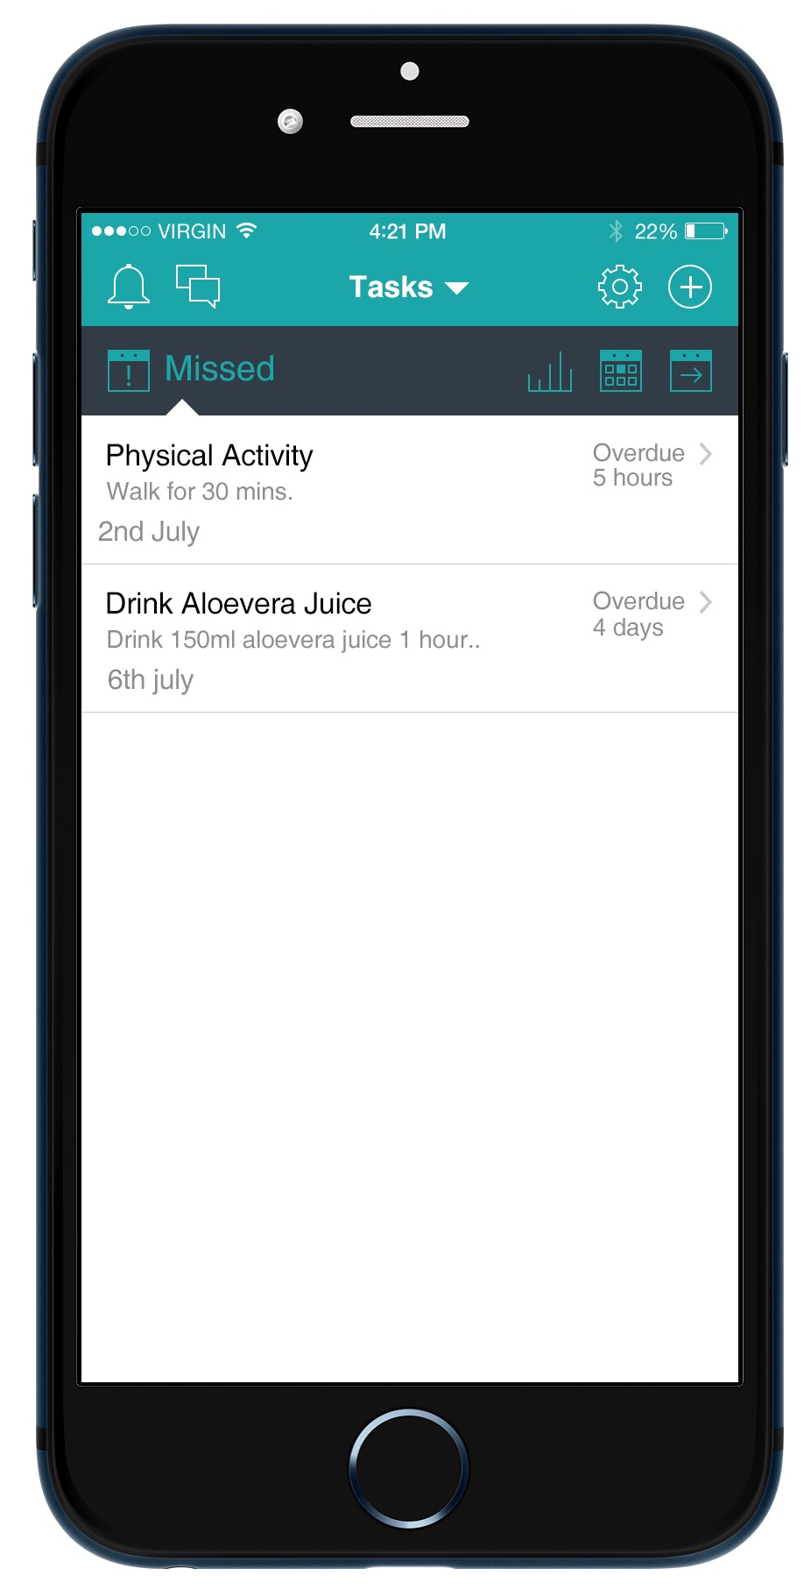
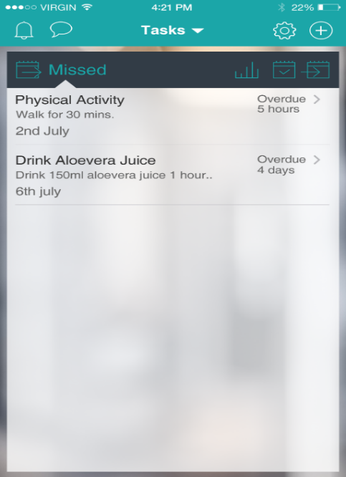
Patient View Notification/SMS
Patient Console
Patient gets alerts/sms in case of any discrepancy found or follow up or if any new education link is made available

Slide 32

Block level / District Health Officer

Slide 33
DHO Console
DHO Console
DHO looks at all the information related to the Programs
HO App/Modules :
Performance of Program
Performance of Stake holders
Analytics – KPI / Targets achieved
RCH Program Trends
ICDS Program Trends
Care Team Performance
Program Outcome
SMS/Chats/Emails
My Calendar
Notes:
RCH – Reproductive and Child Health Care Program
ICDS – Integrated Child Development Scheme

Slide 34
Malnutrition Dashboard
DHO Console
DHO looks at looks at all the information related to the ICDS Program run in Ghodegaon – Maharashtra EAST for specified duration
% of Malnutritious Children
Notes:
RCH – Reproductive and Child Health Care Program
ICDS – Integrated Child Development Scheme

Slide 35
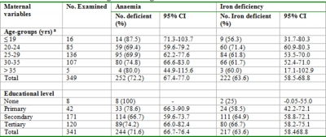
Maternal Anemia and Iron Deficiency Trend
DHO Console
DHO looks at all the program trends on his Tab
Notes:
RCH – Reproductive and Child Health Care Program
ICDS – Integrated Child Development Scheme

Slide 36
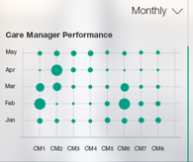
ASHA/AWW/ANM – Care Team Performance
Care Team Performance
Consultant/MO views all the Program level, Stake holder level compliances / performance on his Tab
Stake holder’s
Notes:
RCH – Reproductive and Child Health Care Program
ICDS – Integrated Child Development Scheme

Slide 37
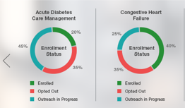
Program Performance
Performance
DHO views Program Performance – Duration , Area wise on his Tab
Pre natal Care Management
Anaemia,Malnutrition management of Children - 0 to 6yrs
Notes:
RCH – Reproductive and Child Health Care Program
ICDS – Integrated Child Development Scheme

Slide 38
DHO Dashboard
DHO Console
% of Enrolled Beneficiaries
% drop outs/Opted out
Performance of Stake holders
Performance of the Program – Area wise , Age group wise, Period wise
Inventory Trends
Expenditure – Program wise, Area wise
Percentage of avoidable maternal deaths
Percentage of maternal deaths due to the third delay (i.e. delay in receiving adequate treatment at a health facility)
Percentage of maternal deaths that occurred in women not scheduled for antenatal care
DHO views performance of the Program as well as Stake holders
Notes:
RCH – Reproductive and Child Health Care Program
ICDS – Integrated Child Development Scheme

Slide 39
Admin Tasks
Admin :
Masters - Creation & Management of different:
Roles
Tasks
Programs
Care Plan templates (nutrition, immunization,medication,physical activity, hygiene…)
Survey & Assessment templates
Configuration of Parameters
Reports layout
User Roles/Privileges
Configuration and Setups
Managing Audit logs

Slide 40
Admin

Slide 41
Proposed Devices
Technology Devices :
Tab : ANM / MO
Tab/ Mobile : ASHA , AWW
Mobile : Patient
Portable Medical Devices:
Hb measuring system
Pulse oximeter
BP Apparatus
Glucometer
Fetal Monitoring System
ECG Monitoring System

Slide 42
Use Cases
Maternal Health Care under MCH/RCH Program
Child Health Care under ICDS Program

Slide 43
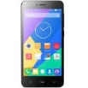
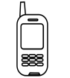

Maternal Health Care
ASHA conducts population survey on device or User Receives an initial outreach SMS engaging them in the programme
Based on survey, ASHA counsel/educate the user for her needs(use of Videos/ You tube links, Pictures & docs)
User consent taken User is enrolled by ASHA into the appropriate program
User is enrolled by ASHA into the appropriate program
ASHA captures survey into system
User is redirected to PHC for further investigations /checkup
The User will be put into a message group based on criteria such as age, care needs etc..
System/user captures/record alcohol usage, exercise, BP, temperature, weight , anthropometric data, Pulse etc.
ASHA captures Demographic data , Family history, ADL, Alcohol , tobacco consumption, symptoms of Problems of the User
ASHA uploads the Data into system
.
ASHA / System captures vitals with the help of device (device integration)
ASHA schedules appointment with PHC center for checkup via App
Appointment Alert send to user /ASHA/ANM/MO
User Information/appointment date displayed to ANM/MO along with appointment schedule and other details
User visits PHC Center - ANM Registers New User or views the record available in the system
Investigations conducted - data entered manually / auto captured in the system (device integration)
System suggests / generates Care Plan for the User
Alerts sent to ANM/MO/ASHA /User in case of discrepancies (Medication skipped, Appointment date missed etc..)
ASHA provides supplements(vitamins), vaccines to User and records it in the system
User will receive voice, text messages / you tube /video/document links on Alcohol/tobacco/smoking quitting along with diet, exercise, medication Plan & counselling , hygiene , environment safety on her HealthMon app
Reminders sent to User /ASHA for scheduled appointments, Vaccinations, Counselling & educational sessions on Child health ,Safe delivery,MTP ,Pre-Intra-Postnatal care & Family Planning
Reminders sent to User for medication , food intake , physical activity , hygiene
ASHA/ANM records User’s feedback on services / Queries in the App
Reports/Analytics are generated and viewed by HO and Care Team
Collaboration (initiated by users or system based on Predefined Schedules or discrepancies in expected outcome)
ANM referrers User to Specialist based on Care needs/severity
Care Plan Modified based on findings and is approved by ANM/MO
Alert/Message sent to Care Team for Modified plan and is viewed by Patient and Team
Patient/Family views & tracks health Status via HealthMon App

Slide 44
Child Health Care
AWW/ASHA conducts population survey
Based on survey, AWW/ASHA counsel/educate the Mother ,Family for Child health & Care
User consent taken User is enrolled by ASHA into the appropriate program
User/Child is enrolled by AWW/ASHA into the program
AWW/ASHA captures survey into system
AWW provides nutrition , supplements(vitamins), vaccines to User and records it in the system
The User/Mother will be put into a message group based on criteria such as age, care needs etc..
AWW uploads the User information into system
AWW/System captures Vitals height,weight,BP,Temp, Pulse etc. with the help of device
AWW records demographic data , Family history , symptoms of the User
AWW/ASHA schedules appointment with PHC center for checkup via App
User Information/appointment date displayed to ANM/MO along with appointment schedule and other details
User visits PHC Center - ANM Registers New User or views the record available in the system
Investigations conducted -data entered manually / auto captured in the system (device integration)
User is redirected to PHC for further investigations /checkup
Appointment Alert send to user /ASHA/ANM/MO
Alerts sent to ANM/MO/ASHA /User in case of discrepancies (Medication skipped, Appointment date missed etc..)
User will receive voice, text messages / you tube /video/document links on Alcohol/tobacco/smoking quitting along with diet, exercise, medication Plan & counselling , hygiene , environment safety on her HealthMon app
Reminders sent to User /AWW for scheduled appointments, Vaccinations, Counselling & educational sessions on Child health
Reminders sent to User/Mother for medication , feeding, child diet , hygiene etc..
System suggests / generates Care Plan for the User
Collaboration (initiated by users or system based on Predefined Schedules or discrepancies in expected outcome)
User’s Family views & tracks health of Child Status via HealthMon App
ASHA/AWW records User’s feedback on services / Queries in the App
Reports/Analytics are generated & viewed by HO and Care Team
ANM referrers User to Specialist based on Care needs/severity
Care Plan Modified based on findings and is approved by ANM/MO
Alert/Message sent to Care Team for Modified plan and is viewed by Patient and Team

Slide 45
List of Overall Activities covered in Modules
Program Creation / Maintenance
Patient Identification – Survey (Age, Marital Status, Demographics)
Education/Counselling
Health Assessment/Survey :
Past History
Present Problems
Family History
ADL
Patient Registration
Demographic Details
Symptoms
Preventive - Education/Counselling
Device Integration to Capture Vitals like Hb, Blood glucose, Pulse, ECG, Fetal Heart Rate, BP etc..
Diagnosis / Investigations
Treatment
Creating Care plan (Plan for Medication, Diet, exercise, investigations, appointments..)

Slide 46
List of Overall Activities covered in Modules
Appointment Scheduling
Referral Management
Reminders/Follow up – SMS/ Alerts, Phone
Tracking
Collaboration
Trainings for Healthcare Workers
Patient Satisfaction Survey
Inventory Management
Generating and Maintaining Records
Analytics – Health Status, Performance of Care Team Members
Admin – User Roles, Privileges , Masters

Slide 47
MO/Consultant views Dashboard
Sample Mockups

Slide 48
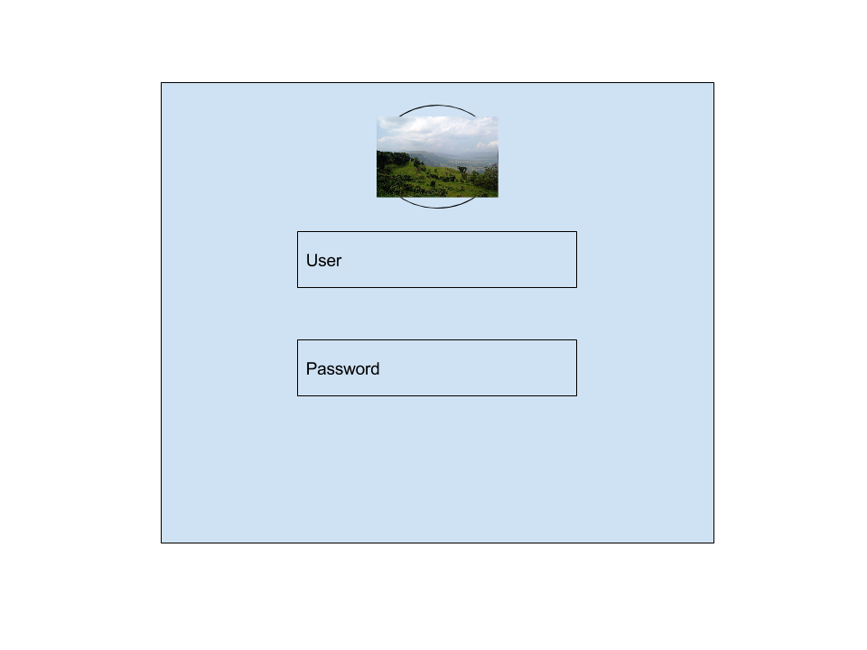
Login Screen
Login Screen
Stake holders logs into HelathMon App

Slide 49
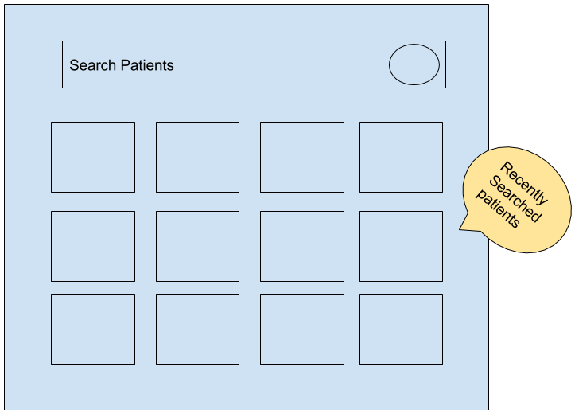
Patient List and Search
Enrolled Patients Screen
Stakeholders views the list of patients enrolled in the program and assigned to him.

Slide 50
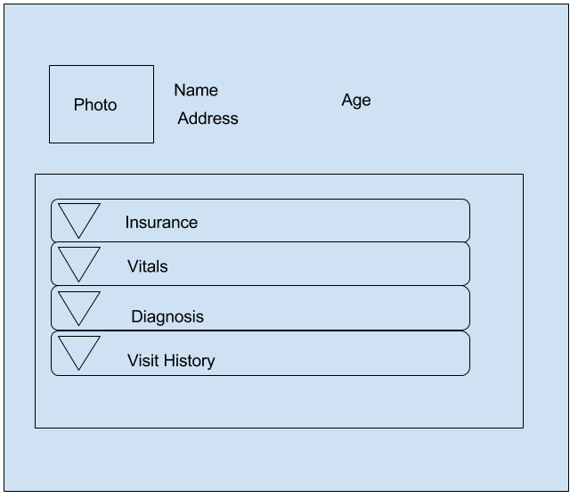
Patient Details
Patient Details
Stake holder records & views Patient details in the App Demographics , Vitals, Diagnosis, Treatment

Slide 51
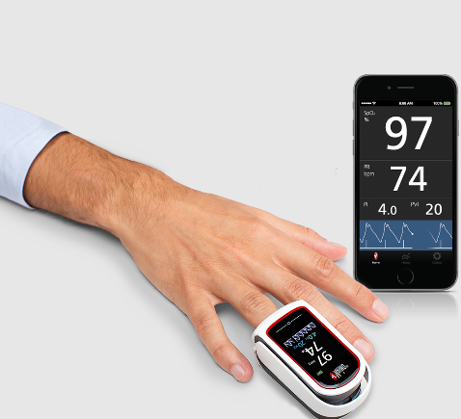
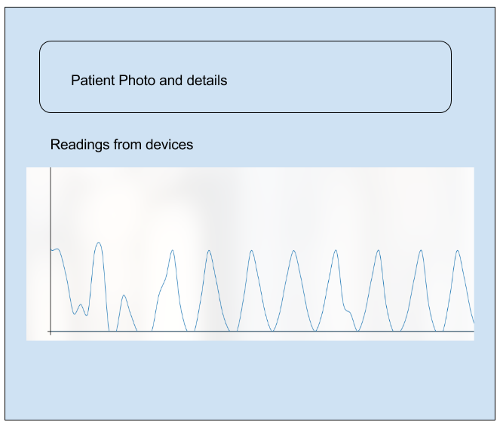
Vitals Recording – POC Device Integration
Vitals Recording
Stake holder captures Vitals with the help of medical devices into App

Slide 52

Thank You

